Slide 1


Serverless Image Conversion

Slide 2


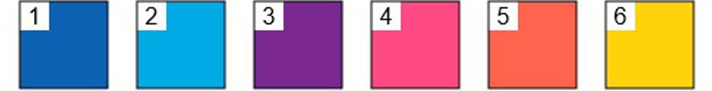
Group Members
Tatheer Zahra
Sujay Koujalgi

Slide 3

Two Parts
Machine Learning
Deploying on the cloud

Slide 4
Part-1: Machine Learning

Slide 5
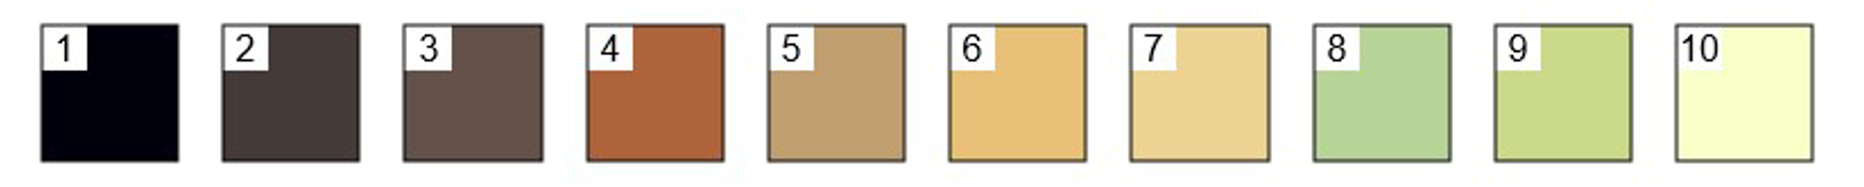

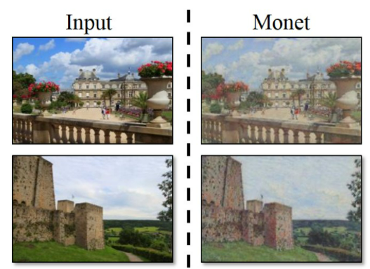
Model: CycleGAN
Started with basic GANs-had generalization issues
Shifted to CycleGAN
CycleGAN provides image to image translation
Input image->CycleGAN->Output image

Slide 6

Our Modifications
Removed conversion from one dataset to another.
Instead of passing an entire dataset, frames from our webcam were passed.
Each frame was considered as an individual image, and modifications were applied to it.

Slide 7
How did we do it?
Obtained pre-trained models of each artist
Used OpenCV and CV2 to extract frames and apply the pretrained model to it
Important functions (VideoCapture(0), read(), etc.)
Passed style(Van Gogh, Monet, Picaso, etc.) as a parameter

Slide 8
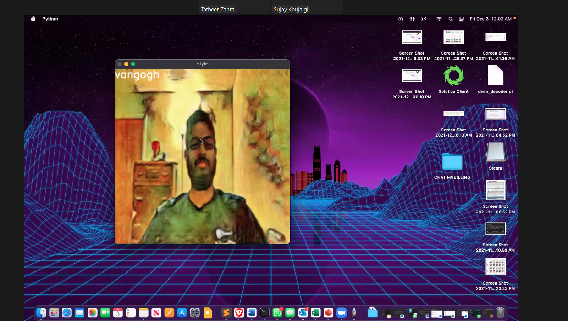
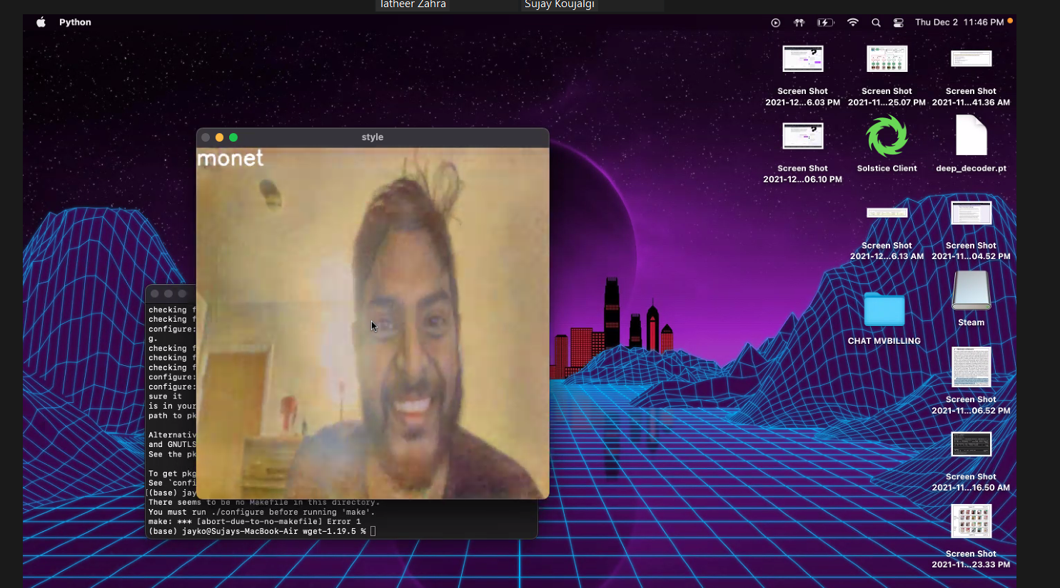
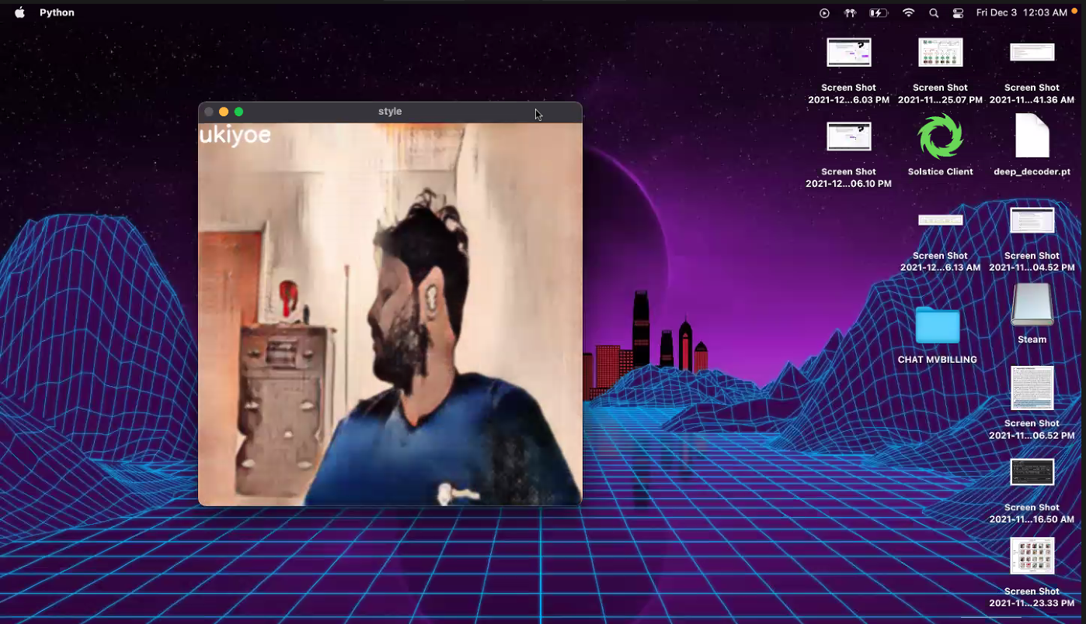
Results

Slide 9
Challenges
Training deep learning models on local system is computationally expensive
Local applications are not accessible to everyone
GPU based solutions are expensive
Cross platform implementation

Slide 10
Why did we choose cloud?
CycleGAN takes 45 hours just to train one dataset on 1 GPU
Takes less time with 64 GPUs
Requires a lot of memory

Slide 11
Part-2: Deploying on cloud

Slide 12

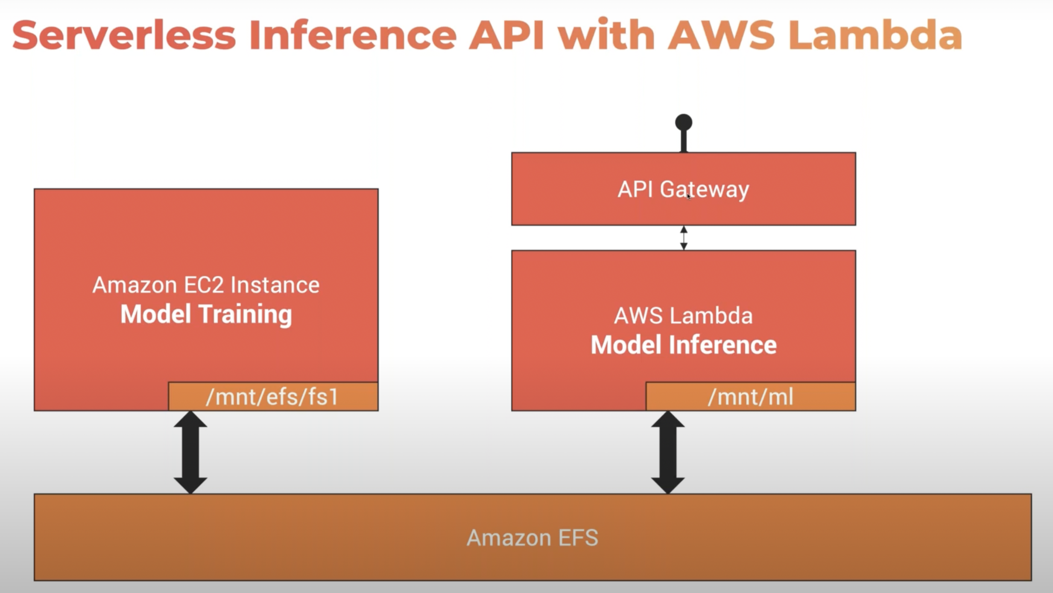
ARCHITECTURE
Phase 2
Phase 1

Slide 13
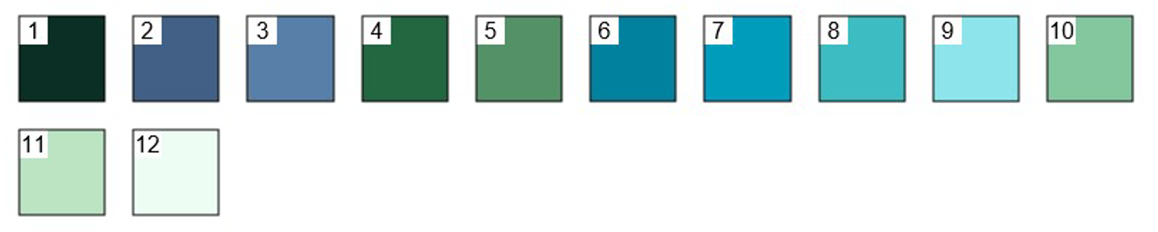
EFS
It is a scalable and elastic cloud storage system.
Considered stable as it is non-volatile.
We imported our entire CycleGAN architecture into it.
For example, our pretrained datasets (Van Gogh, Picaso, etc.) were saved there.
It had bi-directional GAN, one directional GAN, basic model of GAN, etc.
For our application, all nodes would be accessing the same EFS, making it memory efficient.
Even our basic run-time script is saved in EFS.

Slide 14
EC2
It is Amazon’s virtual platform for computing resources
Allows configuring and deploying anything with complete control
Has 400 instances for all kinds of models

Slide 15
EC2: CHALLENGES
Memory issues as we were using free version
Unable to download torch and other python libraries due to less memory
Lack of domain knowledge to make specific decisions

Slide 16
EC2: OUR SOLUTION
We shifted towards a paid version to resolve memory issues
Studied each instance deeply and chose t2. large instance
T2 instances are burstable performance instances
Provides 8 GB RAM, 36 CPU credits/hr, dual core CPU

Slide 17
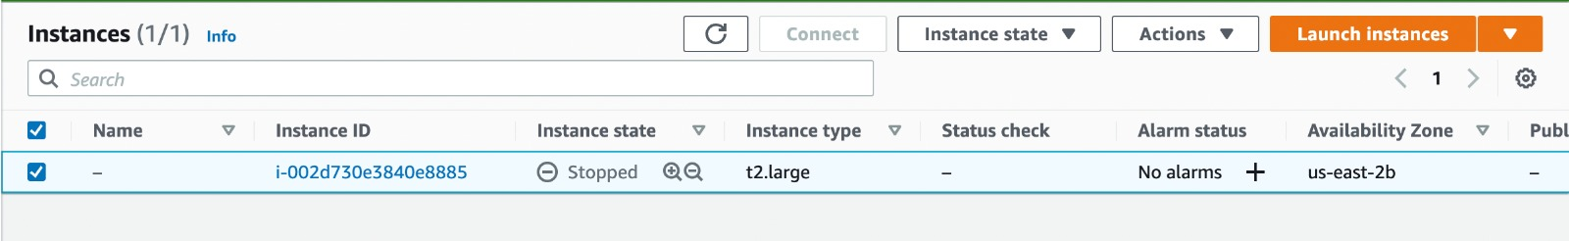
EC2

Slide 18
Lambda
Used for developing serverless architecture over the code and data present in EC2.
Increased the memory to maximum and set the timeout to 30 seconds
Issues: We can’t write to EFS via Lambda. Therefore, we incorporated S3 buckets to interact with Lambda. Additionally, we stored the transformed image to S3 buckets too.

Slide 19
API Gateway and Timeout Error
POST request used to send input image, which invokes EFS.
Lamda can handle processing by using the modules stored in EFS.
Faced Timeout error as it is 30 seconds by default. Since we cannot divide our process into smaller parts
The API gateway has max timeout of 30 secs. The process is dependent and cannot be separated out into smaller chunks. Results in a timeout error.

Slide 20
Why did we face timeout error?
Steps in our application:
Image conversion to base64
Base64 conversion to tensor image
Importing modules from EFS
Run 4 pretrained dataset on one image
Transform edited image to byte stream
Return byte stream to user
All of this cannot be done in 30 seconds

Slide 21
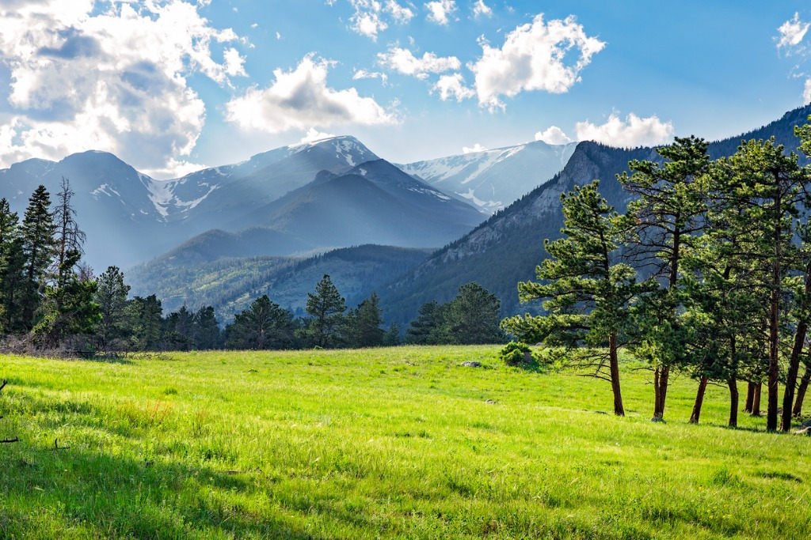
Results from cloud-based solution
ORIGINAL

Slide 22
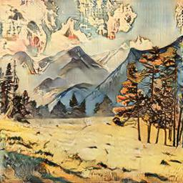
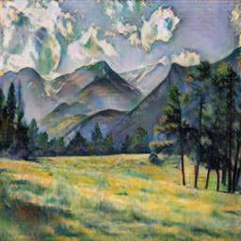
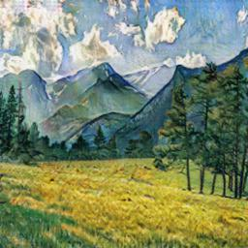

Results from cloud-based solution

